Slide 1

From Stutterer To Speaker: Overcoming Your Fears
Matt Gordon

Slide 2


Slide 3
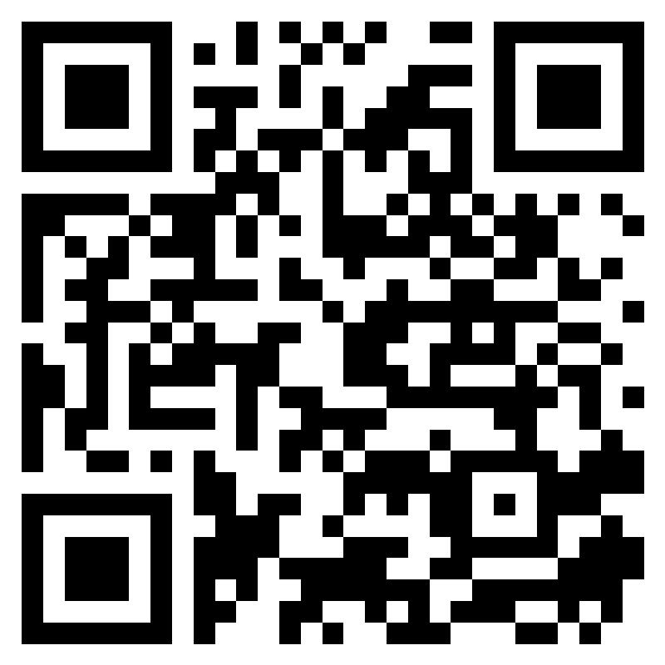
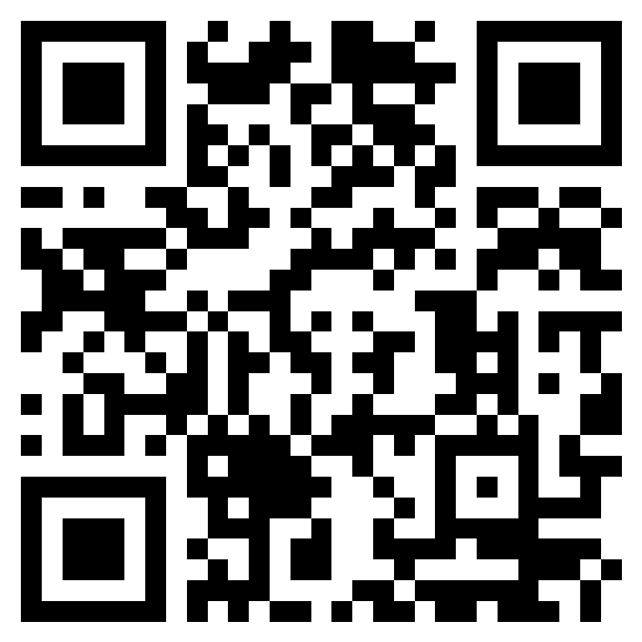
Session Feedback
Event Feedback

Slide 4

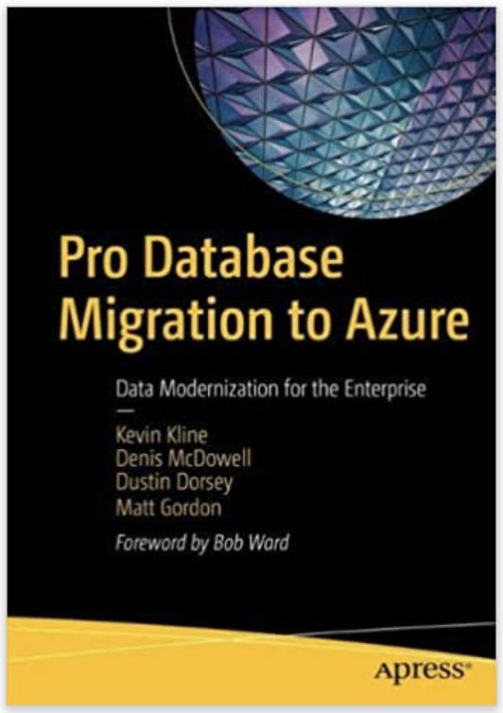

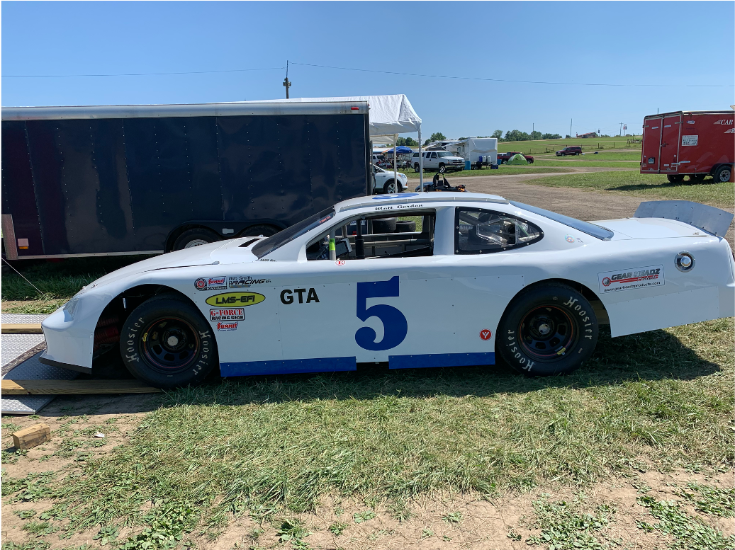

Matt Gordon
Director of Cloud Administration
matt@sqlatspeed.com
: @sqlatspeed
www.sqlatspeed.com

Slide 5
Looking For A New Job?
CLOUD DATA ADMINISTRATOR
CLOUD INFRASTUCTURE ADMINISTRATOR

Slide 6
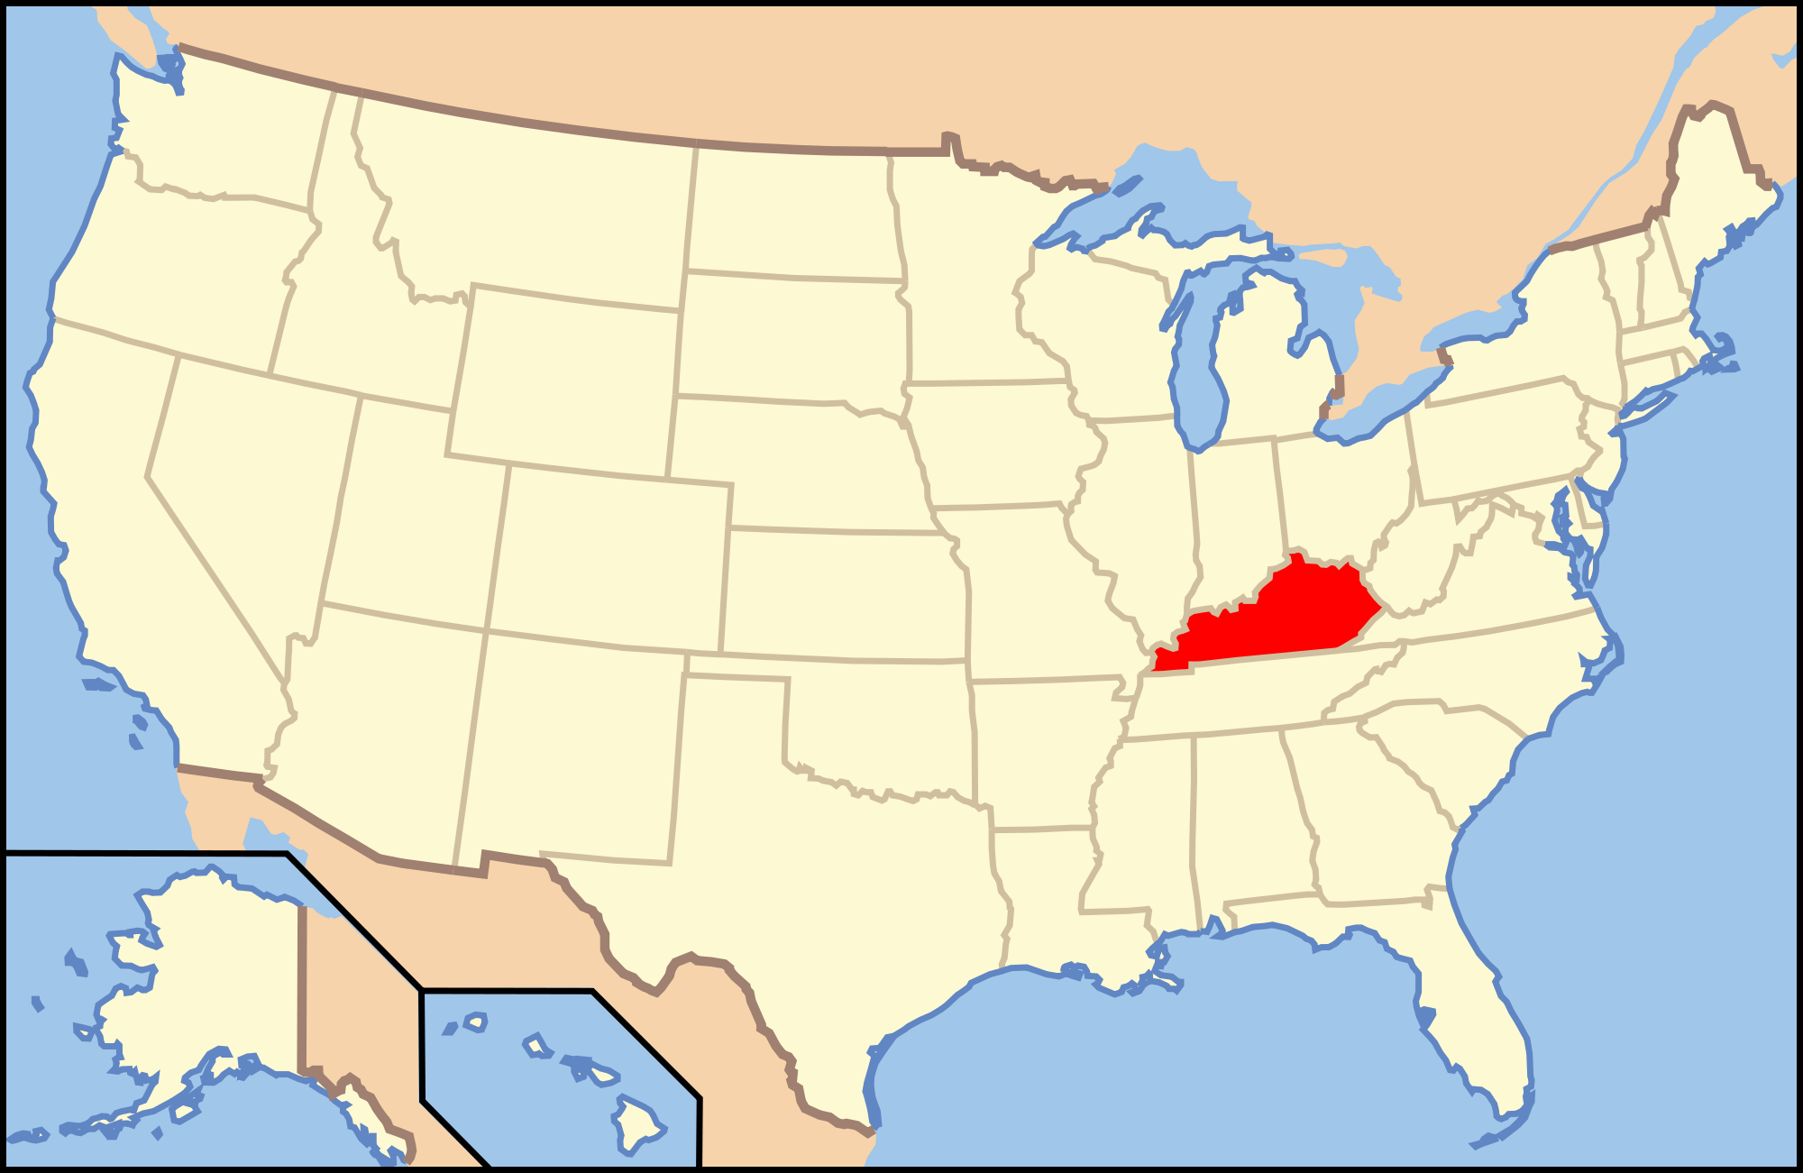
About Me – Where I Live

Slide 7
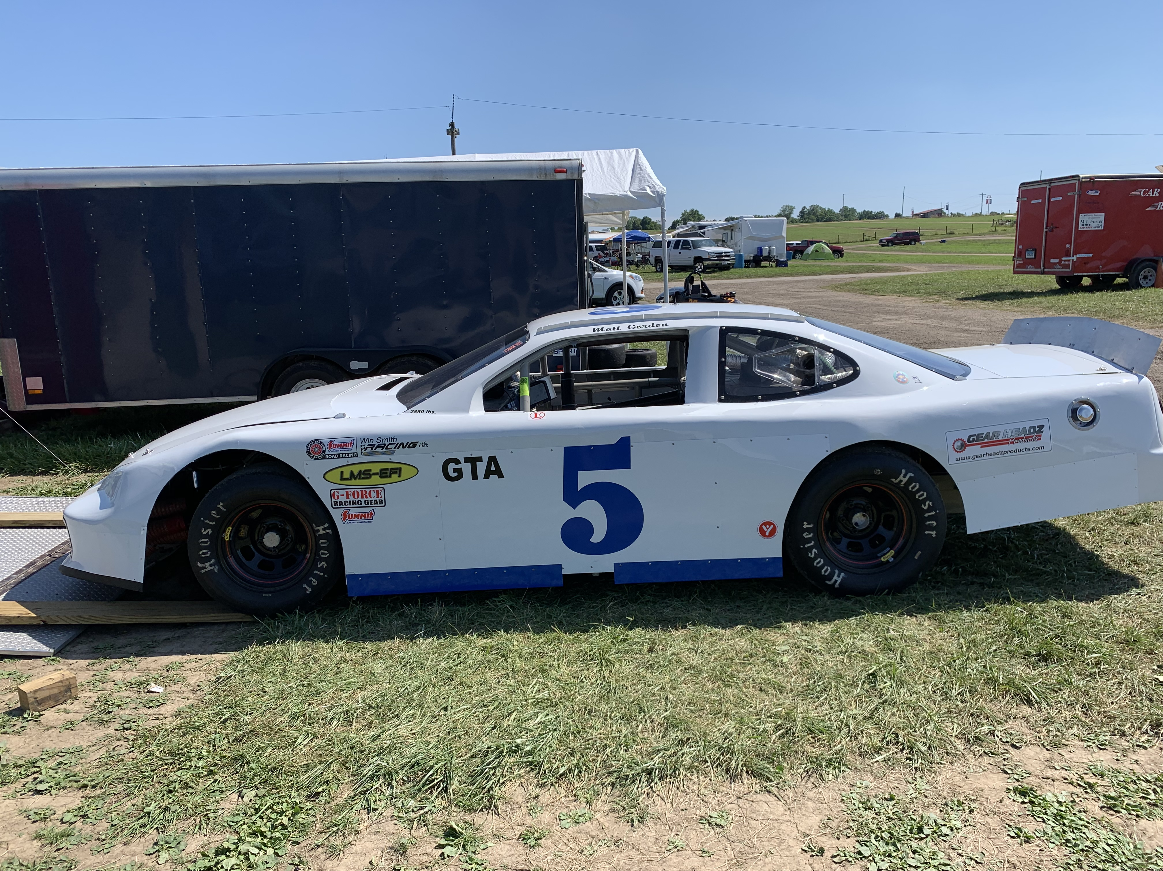
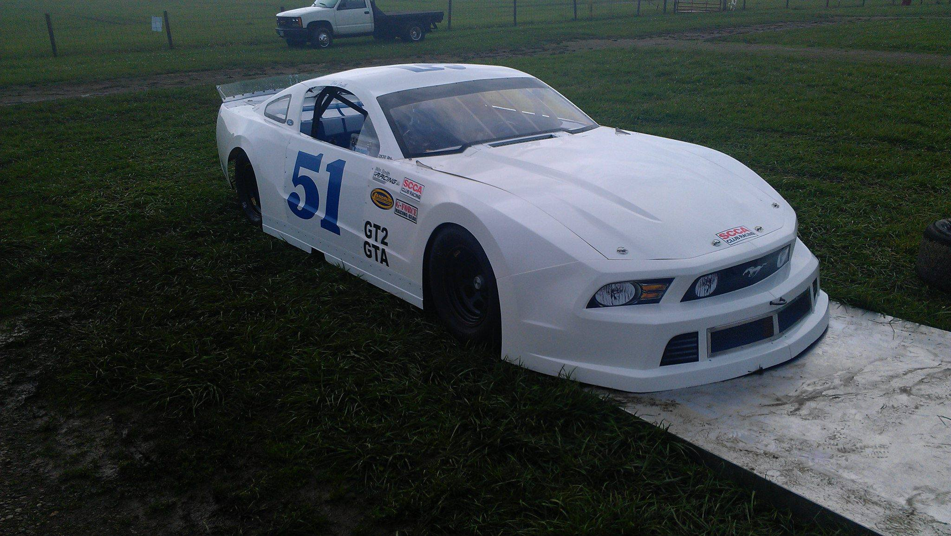

How I Picked My Twitter Handle and Domain Name

Slide 8


About Me
20+ years of SQL Server experience
5+ YEARS OF AZURE AI EXPERIENCE
Microsoft Data Platform MVP
Friend of Redgate
Managed 24x7 datacenters
Leader of Lexington, KY (USA) Data Technology Group

Slide 9
What Fears Are We Overcoming?

Slide 10
SCARIER THAN DEATH?
SURVEY BY BRUSKIN associates rated public speaking #1 fear
Heights were #2, insects/bugs #3, death #7
How has this slide made you feel?

Slide 11
Why is speaking so scary?
Size of the group
Audience notices you’re nervous
Fear of judgment

Slide 12
Why is speaking so scary?
“they’ll know I don’t know anything”
WHAT DO I DO WITH MY HANDS?
“I DON’T KNOW AS MUCH AS …”

Slide 13
Stuttering At The Start

Slide 14
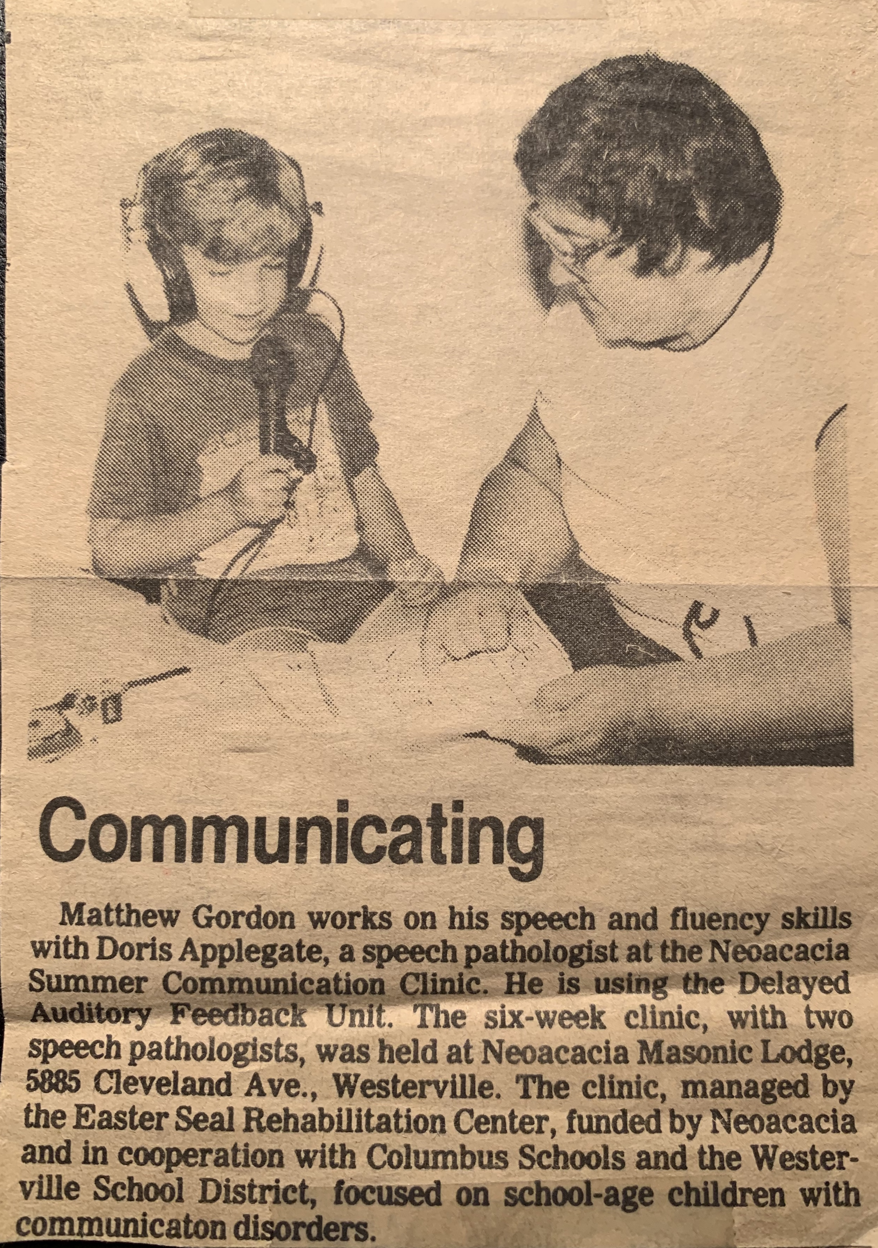
Speech Therapy

Slide 15
What Were The Issues?
Struggled with S sounds and M sounds
Referred to speech therapy
Early family moves complicated the issues

Slide 16
Scared of Speaking

Slide 17
Stories and Scenarios
Refused to read
Really good at faking coughing fits
Rarely made eye contact

Slide 18
Sneaking Out

Slide 19
How Did You Sneak Out?
Bathroom breaks
Creative excuses to go to the school office
Sickness

Slide 20
Some Things Weren’t Sneakable
Good news:
Won an essay content in HS
Bad news:
Had to read my essay to collect my prize
SELECTED any assignment that did not involve being in front of the class

Slide 21
Making Changes

Slide 22
Things Had To Change
College forced new experiences
And Clemson UNIVERSITY had a mandatory public speaking class
Involved in more public organizations
Put into slightly more “public” roles

Slide 23
Things Were Changing
Student paper editor showed faith in me
Finding a supportive community is essential
Did not really translate to classes
Found spaces where I was comfortable being “public”

Slide 24
Career Changes
Graduated college
Transitioned into an isolated IT career
Grew into DBA role
Turned into leadership role for distributed team
Eventually transitioned into consulting

Slide 25
Consulting Turns Into Speaking
“Must is a mighty master”
Personal branding and company promotion
Finding another supportive community

Slide 26
Speaking Style Tips

Slide 27
Tips & Tricks
Work off a rough script
One person’s style doesn’t have to be yours
Speak in your comfort zone
Style-wise and content-wise

Slide 28
Tips & Tricks
Avoid troublesome trip-ups
Start with giving webinars
VIRTUAL EVENTS MAY PROVIDE A NICE TRANSITION TO IN-PERSON
Notes:
Moderating is a nice option here as well

Slide 29
Making Our Way

Slide 30
How Can We Move Forward Together?
Find a community
Reach out to each other
Find a comfort level
Be open and helpful
Pay it forward
Encouragement
Believe in somebody
Notes:
Mention PASS, local groups, etc.
Focus on where folks can get started locally with this (UGs)

Slide 31
Links for Books
Cognitive Services book
Database migration book

Slide 32


QR Codes for Job Links
Cloud Infra Administrator
Cloud Data Administrator

Slide 33
Thanks for coming!
Matt Gordon
Director of Cloud Administration
matt@sqlatspeed.com
: @sqlatspeed
www.sqlatspeed.com
https://github.com/sqlatspeed/2022_presentations

